Slide 1
Architecture of the Kernel
The services provided by the operating system are accessed through the Application Programming Interface (API) to develop application software.
The API is a set of function calls using which you can access the various kernel objects and the services provided by the kernel.
The various kernel objects are: Tasks, Task scheduler, Interrupt Service Routines, Semaphores, Mutexes, Mailboxes, Message queues, Event registers, Pipes, Signals and Timers.
The API of the operating system gives the function calls to manage these objects.
The kernel provides various services through operations on the kernel objects. These services are: memory management, device management, interrupt handling and time management.

Slide 2
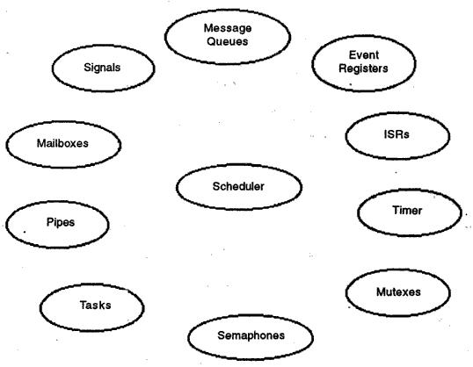
Fig 1. Kernel Objects

Slide 3
Tasks and Tasks Scheduler
A task is an independent thread of execution that can compete with other concurrent tasks for processor execution time. Developers decompose applications into multiple concurrent tasks to optimize the handling of inputs and outputs within set time constraints.
The embedded s/w tasks include OS tasks as well as a the application-specific tasks. Each task in an embedded system is implemented as an infinite loop.
The task object consists of its name, a unique ID, a priority, a stack and a Task Control Block that contains all the information related to the task.
Apart from tasks required for the application software, the kernel has its own system tasks with priorities

Slide 4
Tasks and Tasks Scheduler
These tasks are:
Startup task, which is executed when the operating system starts
Exception handling task to handle the exceptions
Logging task to log the various system messages
Idle task, which will have the lowest priority and will run when there is no other task to run. This task ensures that the CPU is not idle

Slide 5
Tasks and Tasks Scheduler
Single CPU has to handle multiple tasks, that share the CPU time in a disciplined manner so that one task does not get lot of time while others are waiting forever.
Therefore, each task has to be assigned a priority; and a mechanism for deciding which task will get CPU time next has to be worked out. This is known as task scheduling.
The object that does task scheduling is the task scheduler.
In addition to the CPU time, the tasks have to share the system resources such as CPU registers, external memory and input/output devices.

Slide 6
Tasks and Tasks Scheduler
While scheduling the tasks, a number of issues, as described below, need to be kept in mind:
Reentrant function and non-reentrant function.
Interrupts are disabled before the start of the execution of the code's critical section and enabled after the execution is completed. Kernel objects such as semaphores are used to protect the data.
Tasks should maintain discipline to access shared resources. Semaphore and mutexes are used to share resources with discipline.
Tasks may need to communicate data amongst themselves. Inter-task communication needs to be achieved through special mechanisms such as mailboxes, message queues, pipes, event registers, and signals.

Slide 7
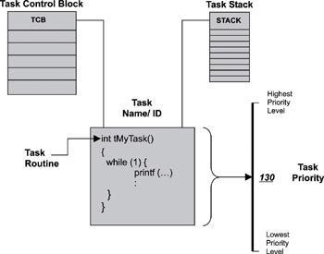

Slide 8
Tasks and Tasks Scheduler
Tasks States
In an embedded system, each task has to do a specific job.
For instance, consider an embedded system that obtains data from a serial port and converts the data into Ethernet packets.
TASK1: reads the data from a serial port
TASK 2: keeps converting the serial data into packets and puts them in a buffer.
TASK 3: reads the buffer and sends it over an Ethernet interface.
At any instant, only one task is being executed by the CPU whereas other tasks are either waiting for some external event to occur or waiting for the CPU time.

Slide 9
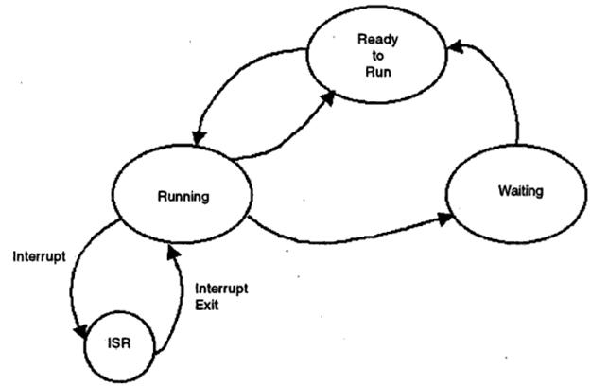
Fig 2. States of a Task

Slide 10
Tasks and Tasks Scheduler
Running state: A task is said to be in running state if it is being executed by the CPU.
Waiting state: A task is said to be in waiting state if it is waiting for another event to occur.
Ready-to-Run state: A task is said to be in Ready-to-Run state if it is waiting in a queue for the CPU time.
A task which is in waiting state can move to the Ready-to-Run state after the external event occurs. It cannot move directly to the Running state.
A task which is in Ready-to-Run state can move to the Running state.
A task in the Running state can move to the Waiting state if it has to wait for an external event to occur; or it can move to the Ready-to-run state if its job is not completed, but the CPU has to run another task.

Slide 11
Tasks and Tasks Scheduler
A task which is presently running may be interrupted to run an ISR for a short time. After the ISR is executed, the CPU continues to execute the task which was interrupted or the highest priority task which is Ready-to-Run. The ISR can do the job of changing the state of a task. For instance, a high priority task which was in waiting state has to move to Ready-to-Run state.
Task stack: Every task will have a stack that stores the local variables, function parameters, return addresses and CPU registers during an interrupt. At the time of creating a task, the size of the stack has to be specified or a default stack size has to be used.

Slide 12
Tasks and Tasks Scheduler
Context Switching
The state of the CPU registers when a task is to be pre-empted is called the context. Saving the contents of the CPU registers and then loading the new task is called context switching.

Slide 13
Tasks and Tasks Scheduler
Scheduling Algorithms
Depending on the requirement of the embedded system, the scheduling algorithm needs to be chosen.
First In First Out
Round-robin algorithm
Round-robin with priority
Shortest job first
Non-preemptive multitasking
Preemptive multitasking

Slide 14
Tasks and Tasks Scheduler
First In First Out (FIFO)
the tasks which are Ready-to-Run are kept in a queue and the CPU serves the tasks on first-come-first served basis.
Very simple to implement
Difficult to estimate the amount of time a task has to wait for being executed.
A good algorithm for an embedded system has to perform few small tasks all with small execution times.
If there is no time criticality and the number of tasks is small, this algorithm can be implemented.

Slide 15
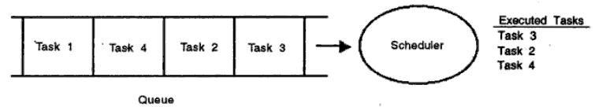
Tasks and Tasks Scheduler
Fig 3. Scheduling Algorithm: FIFO

Slide 16
Tasks and Tasks Scheduler
Round-robin Algorithm
In round-robin algorithm, each task waiting in the queue is given a fixed time slice. The time slice allocated to each task is called quantum.
The kernel gives control to the next task if
The current task has completed its work within the time slice
The current task has no work to do
The current task has completed its allocated time slice
very simple to implement
there are no priorities for any task
Sufficient for non time-critical operations.

Slide 17
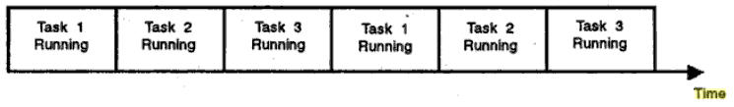
Tasks and Tasks Scheduler
Fig 4. Round-robin scheduling algorithm

Slide 18
Tasks and Tasks Scheduler
Round-robin with Priority
The round-robin algorithm can be slightly modified by assigning priority levels to some or all the tasks.
A high priority task can interrupt the CPU so that it can be executed.
This scheduling algorithm can meet the desired response time for a high priority task.
For example, in a bar code scanner, high priority is assigned to the scanning operation. The CPU can execute this task by suspending the task that displays the item/price value. Soft real-time systems can use this algorithm.

Slide 19
Tasks and Tasks Scheduler
Shortest-Job First
This is like a priority assignment, the priority being decided by the amount of time—the higher the execution time, the lesser the priority.
The advantage of this scheduling algorithm is that a high number of tasks will be executed.
But the task with the highest amount of time will have to wait, perhaps forever!

Slide 20
Tasks and Tasks Scheduler
It is the task scheduling algorithm which decides whether the necessary time constraints can be met or not. If the embedded system is a hard-real time system, none of the above scheduling algorithms can be used at all.
The kernels used in embedded systems can implement priority-based multi-tasking scheduling algorithms of two types:
Non-preemptive multi-tasking
Preemptive multitasking

Slide 21
Tasks and Tasks Scheduler
Non-Preemptive Multi-Tasking
In non-preemptive multitasking, the tasks cooperate with each other to get their share of the CPU time.
Each task has to release the CPU and give control to another task on its own. Each task is given a priority, but the priority has to be respected by the other tasks.
If interrupts are enabled, a high priority task can interrupt the running task and make the high priority task Ready-to-Run.
After the ISR is executed, the CPU will continue to execute the low priority task only. And, when the low priority task releases the CPU, the high priority task is executed.
Disadvantage: a high priority task may have to wait for a long time. Also, it is not possible to determine the exact response times for each of the tasks.

Slide 22
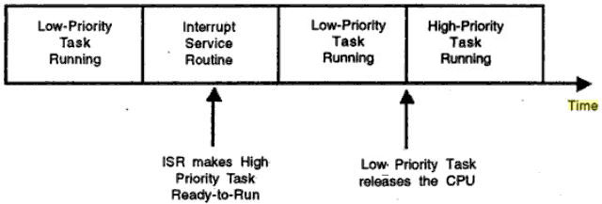
Tasks and Tasks Scheduler
Fig 5. Non-preemptive Multitasking

Slide 23
Tasks and Tasks Scheduler
Preemptive Multi-tasking
In preemptive multitasking, the highest priority task is always executed by the CPU, by preempting the lower priority task. All real-time operating systems implement this scheduling algorithm.
If a lower priority task is presently running and a higher priority task is in Ready-to-Run state, the running task is "preempted" and the higher priority task is executed.
If there are a number of tasks in the Ready-to-Run state, the task with the highest priority is always given the first chance by the task scheduler.
The main attraction of this scheme is that the execution time of the highest priority task can be calculated and hence the kernel is said to be deterministic.
Most of the commercial embedded operating systems use preemptive multitasking to meet real time requirements.

Slide 24
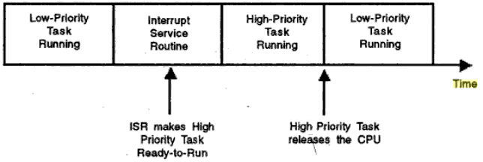
Tasks and Tasks Scheduler
Fig 6. Preemptive Multitasking

Slide 25
Tasks and Tasks Scheduler
Rate Monotonic analysis
Priority assignment to a task can be static or dynamic.
In static priority assignment, a task will be assigned a priority at the time of creating the task and it remains the same.
In dynamic priority assignment, the priority of the task can be changed during execution time.
The Rate Monotonic Analysis used for assigning priorities.

Slide 26
Tasks and Tasks Scheduler
RMA makes the following assumptions:
Highest priority task will run first, i.e. the priority-based preemptive multitasking is the scheduling algorithm.
All the tasks run at regular intervals i.e. the tasks are periodic.
Tasks do not synchronize with each other, i.e. they do not share resources or share data (which is not a valid assumption).
the priority is proportional to the frequency of execution.

Slide 27
Tasks and Tasks Scheduler
In RMA, if n is the total number of tasks, the eq^{n} for schedulability test is given by,
∑(Ei/Ti) ≤ U(n) = n(2^{1/n} – 1)
Ti: execution period of ith task
Ei: execution time of ith task
Ei/Ti: percentage of the CPU time required for the execution of ith task.
U(n): Utilization factor.
Schedulability test indicates how much CPU
CPU time is actually utilized by the tasks.
If the number of task is infinity, then about 70%
of CPU time is utilized.
n | U(n)
1 | 1.000
2 | 0.828
3 | 0.779
4 | 0.756
Infinity | 0.639

Slide 28
Tasks and Tasks Scheduler
Task Management Function Calls
The various function calls provided by the OS API for task management are:
Create a task
Delete a task
Suspend a task
Resume a task
Change priority of a task
Query a task

Slide 29
Interrupt Service Routine
Interrupt is a hardware signal that informs the CPU that an important event has occurred. When interrupt occurs, CPU saves its context and jumps to the ISR. After ISR processes the event, the CPU returns to the interrupted task in a non-preemptive kernel. In the case of preemptive kernel, highest priority task gets executed.
Interrupt Latency: The maximum time for which interrupts are disabled + time to start the execution of the first instruction in the ISR is called interrupt latency.
Interrupt Response Time: Time between receipt of interrupt signal and starting the code that handles the interrupt is called interrupt response time. In a preemptive kernel, response time = interrupt latency + time to save CPU registers context.

Slide 30
Interrupt Service Routine
Interrupt Recovery Time: Time required for CPU to return to the interrupted code/highest priority task is called interrupt recovery time.
In non-preemptive kernel, interrupt recovery time = time to restore the CPU context + time to execute the return instruction from the interrupted instruction.
In preemptive kernel, interrupt recovery time = time to check whether a high priority task is ready + time to restore CPU context of the highest priority task + time to execute the return instruction from the interrupt instruction.

Slide 31
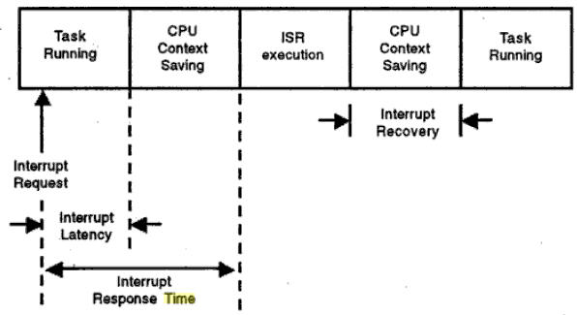
Interrupt Service Routine
Fig 7. Interrupt Latency, Interrupt Response Time and Interrupt Recovery Time

Slide 32
Semaphores
When multiple tasks are running, two or more tasks may need to share the same resource.
Assume that task1 wants to display the message "temperature is 50" and task2 has to display the message "humidity is 40%".
The display is a shared resource and if there is no synchronization between the tasks, then a garbled message is displayed.
To access a shared resource, there should be a mechanism so that there is discipline. This is known as resource synchronization.

Slide 33
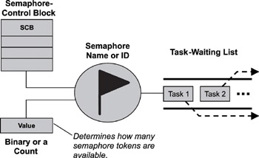
When a semaphore is first created, the kernel assigns to it an associated
semaphore control block (SCB), a unique ID, a value (binary or a count),
and a task-waiting list, as shown in figure.

Slide 34
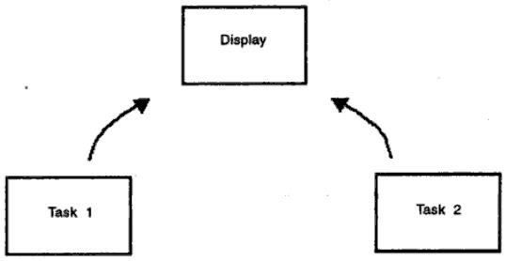
Semaphores
Fig 8. Resource synchronization

Slide 35
Semaphores
One task reads the data from an ADC and writes it to memory. Another task reads that data and sends it to a DAC.
The read operation takes place only after write operation and it has to be done very fast with minimal time delay.
There should be a mechanism for task1 to inform task2 that it has done its job.
This has to be done through a well-defined procedure. This is known as task synchronization.
Semaphore is a kernel object that is used for both resource synchronization and task synchronization.

Slide 36
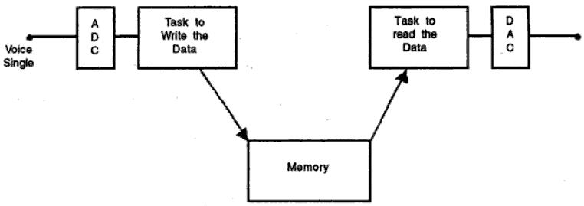
Semaphores
Fig 9. Task synchronization

Slide 37
Semaphores
Two tasks want to access a display which is a shared resource. To control the access, a semaphore is created.
If task1 wants to access the printer, it acquires the semaphore, uses the printer and then releases the semaphore.
If both the tasks want to access a resource simultaneously, the kernel has to give the semaphore only to one of the tasks.
This allocation may be based on the priority of the task or on first-come-first-served basis.
If a number of tasks have to access the same resource then the tasks are kept in a queue and each task can acquire the semaphore one by one.

Slide 38
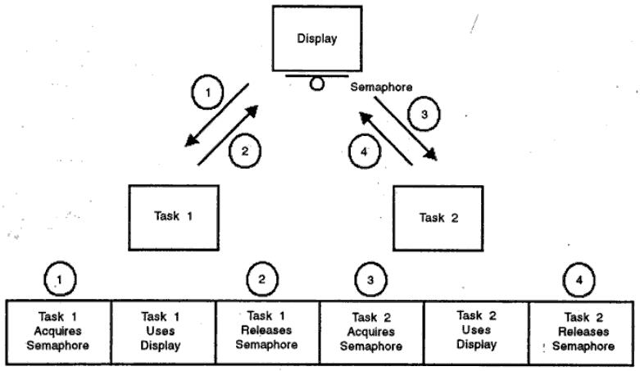
Fig 9. Display Semaphore

Slide 39
Semaphores
Suppose a pool of 10 buffers is available that need to be shared by a number of tasks. Any task can write to a buffer.
Using a binary semaphore does not work in this case. So, a counting semaphore is used.
The initial value of the semaphore is set to 10.
Whenever a task acquires the semaphore, the value is decremented by 1 and whenever a task releases the semaphore, it is incremented by 1.
When the value is 0, it is an indication that the shared resource is no longer available. A counting semaphore is like having multiple keys

Slide 40
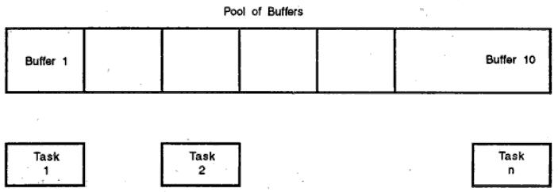
Semaphores
Semaphore is just an integer. Semaphores are of two types: counting semaphore and binary semaphore. Counting semaphore will have an integer value greater than 1. Binary semaphore will take the values of either 0 or 1.
Fig 9. Counting Semaphore

Slide 41
Semaphores
Semaphore Management Function Calls
Create a semaphore
Delete a semaphore
Acquire a semaphore
Release a semaphore
Query a semaphore

Slide 42
Mutex
Mutex stands for mutual exclusion. Mutex is the general mechanism used for both resource synchronization as well as task synchronization. Mutual exclusion can be achieved through the following mechanisms:
Disabling the scheduler: If the scheduler itself is disabled, the currently running task can complete its work on the shared resource. An excellent idea, but a very dangerous idea too! Due to some problem in the presently running task, if the scheduler cannot be enabled again, the system will crash.
Disabling the interrupts: A task in the Waiting state will move to the Ready-to-Run state through an ISR. If the interrupts are disabled, this movement will not happen. So, a solution for mutual exclusion is to disable the interrupts, execute the critical section of the code for using the shared resource and then enable the interrupts. This is certainly a good solution, but the interrupt latency will be more.

Slide 43
Mutex
Test-and-set operations: When two tasks have to share a resource, the functions in each of the tasks can check the value of a global variable to obtain the status of the shared resource. For instance, a global variable 'x' can be set to 0 if the resource can be used and it can be set to '1' if it cannot be used. The procedure is:
Disable the interrupts
Set the variable
Access the shared resource
Set the variable
Enable the interrupts

Slide 44
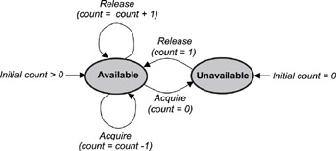
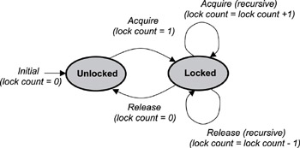

Slide 45
Mutex
Using semaphore
Note that mutex is a special binary semaphore
A mutex can be either in locked state or unlocked state. A task acquires (locks) a mutex and after using resource, releases (unlocks) it.
It is much more powerful than semaphore because of its special features listed below:
Initially, the mutex is in unlocked state. The task which acquires it is the owner. Only the task that is the owner can release the mutex, not any other task.
Owner can acquire a mutex multiple times in the locked state. If the owner locks it 'n' times, the owner has to release it 'n' times.
A task owning a mutex, cannot be deleted.
The mutex supports priority inheritance protocol to avoid priority inversion problem.

Slide 46
Mutex
The operating system function calls provided for mutex management are:
Create a mutex
Delete a mutex
Acquire a mutex
Release a mutex
Query a mutex
Wait on a mutex
Mutex and semaphore can be used for a number of activities such as: to control access to a shared resource; to indicate (signal) the occurrence of an event; and, to synchronize the activities of tasks.

Slide 47
Mutex
Deadlock
Deadlock occurs when two or more tasks wait for resource being held by another task.
To avoid deadlock, a time limit can be set.
When a task is waiting for a semaphore or mutex, it can wait for a fixed time; if even after this wait, the resource is not available, the queue can be emptied.

Slide 48
Mailboxes
A mailbox object is just like the postal mailbox. Someone posts a message in your mailbox and you take out the message. A task can have a mailbox into which others can post a mail. A task or ISR sends the message to the mailbox.
To manage the mailbox object, the following function calls are provided in the operating system API:
Create a mailbox
Delete a mailbox
Query a mailbox
Post a message in a mailbox
Read a message from a mailbox

Slide 49
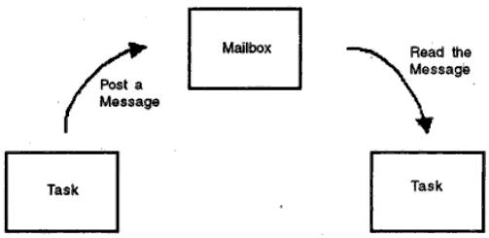
Mailboxes
Fig 10. Inter-task Synchronization through Mailbox

Slide 50
Message Queues
Message queue can be considered as an array of mailboxes. Some of the applications of message queue are:
Taking the input from a keyboard
To display output
Reading voltages from sensors or transducers
Data packet transmission in a network
In each of these applications, a task or an ISR deposits the message in the message queue. Other tasks can take the messages. Based on the application, the highest priority task or the first task waiting in the queue can take the message.
While creating a queue, the queue is given a name or ID, queue length, sending task waiting list and receiving task waiting list.

Slide 51
Message Queues
The following function calls are provided to manage message queues:
Create a queue
Delete a queue
Flush a queue
Post a message in queue
Post a message in front of queue
Read message from queue
Broadcast a message
Show queue information
Show queue waiting list

Slide 52
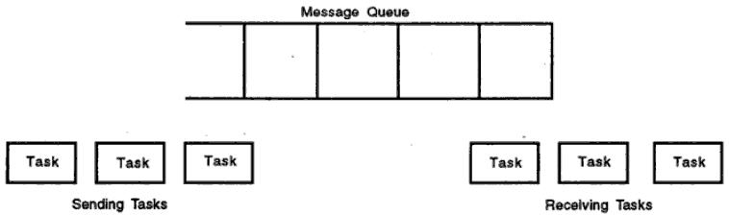
Message Queues
Fig 11. Message Queue

Slide 53
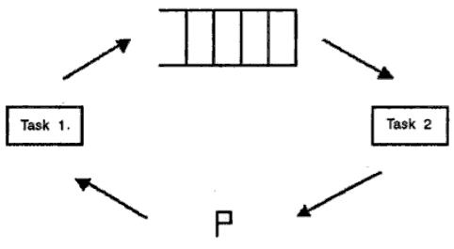
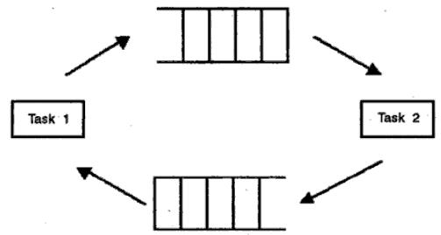
Fig 12. One-way Communication with ACK
Fig 13. Two-way Communication

Slide 54
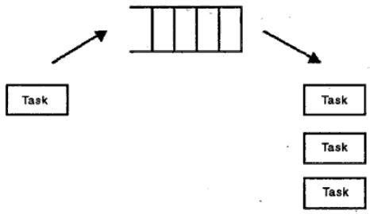
Message Queues
Fig 14. Broadcasting

Slide 55
Message Queues
One-way data communication
A task can send messages to the queue which are read by the other task. For each message received, the second task uses a semaphore to indicate an acknowledgement.
Two-way data communication
two tasks can have two queues to send messages in both directions.
Broadcast communication
a task can send messages to the queue which are broadcast to a number of tasks

Slide 56
Event Registers
A task can have an event register in which the bits correspond to different events.
The 16 bits are divided into four portions corresponding to the events of three tasks and one ISR.
For example, task2 can set the first four bits to 1 or 0. Using a predetermined protocol, the meaning for each of these bits is decided. Task1 comes to know the status of events from these bits. Each of the bits in the event register is an event flag.
Each bit in an event register can be used to obtain the status of an event. A task can have an event register and other tasks can set/clear the bits in the event register to inform the status of an event. The meaning of 1 or 0 for a particular bit has to be decided beforehand.

Slide 57
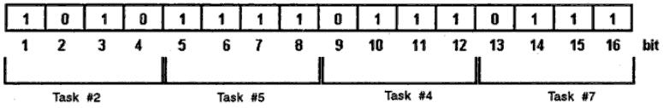
Event Registers
Fig 15. 16-bit Event Register

Slide 58
Event Registers
For managing the event registers, the following function calls are provided:
Create an event register
Delete an event register
Query an event register
Set an event flag
Clear an event flag

Slide 59
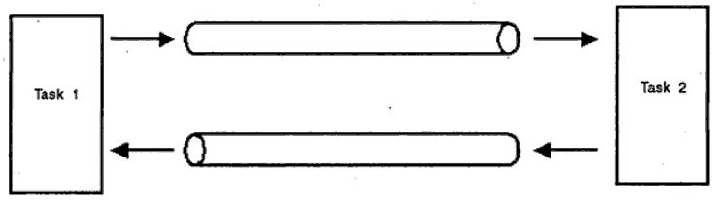
Pipes
A task can write into a pipe and the other task reads the data that comes out of the pipe. In other words, the output of one task is passed on as input to the other task. Task-to-task or ISR-to-task data transfer can take place using pipes.
Fig 16. Pipes for Inter-task Communication

Slide 60
Pipes
Pipes can be used for inter-task communication. One task may send the data packets through one pipe and the other task may send acknowledgements through the other pipe.

Slide 61
Pipes
The function calls in the operating system API to manage the pipes are:
Create a pipe
Open a pipe
Close a pipe
Read from the pipe
Write to the pipe

Slide 62
Signals
Signals can be passed to indicate an event. However, many RTOS do not support it then and their use is discouraged. Again, in shell commands, the signals are sent to kill a process.
$kill -9 879

Slide 63
Signals
The function calls to manage a signal are:
Install a signal handler
Remove an installed signal handler
Send a signal to another task
Block a signal from being delivered
Unblock a blocked signal
Ignore a signal

Slide 64
Timers
Timers are used to measure the elapsed time of events. For instance, the kernel has to keep track of different times:
A particular task may need to be executed periodically, say, every 10 msec. A timer is used to keep track of this periodicity.
A task may be waiting in a queue for an event to occur. If the event does not occur for a specified time, it has to take appropriate action.
A task may be waiting in a queue for a shared resource. If the resource is not available for a specified time, an appropriate action has to be taken.

Slide 65
Timers
The following function calls are provided to manage the timer:
Get time
Set time
Time Delay (in system clock ticks)
Time delay (in seconds)
Reset timer

Slide 66
Memory Management
In addition to the kernel objects memory management is an important service provided by the kernel. The API provides the following function calls to manage memory:
Create a memory block
Get data from memory
Post data in the memory
Query a memory block
Free the memory block

Slide 67
Priority Inversion Problem
When tasks share a resource, there is a possibility of getting into a problem, known as priority inversion problem.
Priority inversion problem arises when a high priority task has to wait while a lower priority task executes. To overcome this problem, priority inheritance protocol is used.
to start with, the MP task and HP task are in the Waiting state and the LP task is Running.
After some time, LP gets a mutex for a shared resource (SR) and performs some operations on the shared resource, but it still has not completed its operations.
Meanwhile, the HP is Ready-to-Run and hence the HP task is executed by the CPU. Now the HP wants the mutex of the shared resource being held by LP task. So, HP task is moved to the Waiting state and the LP task is executed

Slide 68
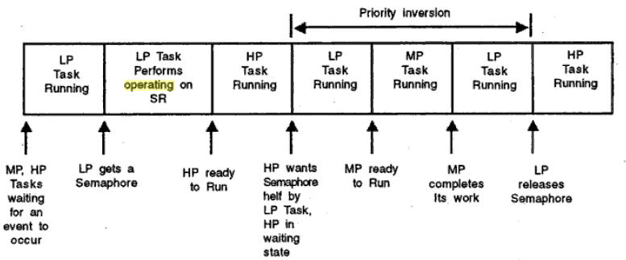
Fig 17. Priority Inversion Problems

Slide 69
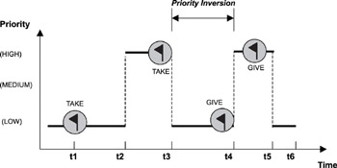

Slide 70
Priority Inversion Problem
After some time, the MP task is Ready-to-Run and hence the LP task is preempted and the MP task is Running.
The MP task completes its job and now the LP task is Running.
When LP task releases the mutex, HP task acquires it and now this task gets executed.
In this process, the high priority task has to wait for a very long time, in spite of its high priority due to the semaphore held by the LP task.
This problem is called the priority inversion problem because the priorities of LP task and HP task are effectively inversed!

Slide 71
Priority Inversion Problem
Priority Inheritance
When the LP task acquires the mutex, its priority can be increased to a value more than the priority of the HP task.
Kernel has to automatically change this priority.
In such a case, the LP task will complete its work very fast and release the mutex which can be acquired by the HP task.
Generally, in Priority Inheritance, the priority of the task which acquired the mutex will be increased to a value higher than the priority of the task competing for that resource.

Slide 72
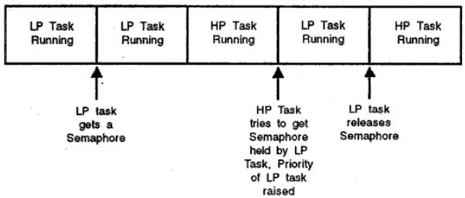
Priority Inversion Problem
Fig 17. Priority Inheritance

